Slide 1

Database Environment
Lecture 2
UECS 1203
DATABASE SYSTEM FUNDAMENTALS

Slide 2
Database Environment - Objective
Purpose of three-level database architecture.
Contents of external, conceptual, and internal levels.
Purpose of external/conceptual and conceptual/internal mappings.
Meaning of logical and physical data independence.
Distinction between DDL and DML.
A classification of data models.

Slide 3
Objectives
Purpose/importance of conceptual modeling.
Typical functions and services a DBMS should provide.
Software components of a DBMS.
Meaning of client–server architecture and advantages of this type of architecture for a DBMS.
Function and uses of Transaction Processing Monitors.
Function and importance of the system catalog.

Slide 4
Objectives of Three-Level Architecture
All users should be able to access same data.
A user's view is immune to changes made in other views.
Users should not need to know physical database storage details.

Slide 5
Objectives of Three-Level Architecture
DBA should be able to change database storage structures without affecting the users' views.
Internal structure of database should be unaffected by changes to physical aspects of storage.
DBA should be able to change conceptual structure of database without affecting all users.

Slide 6
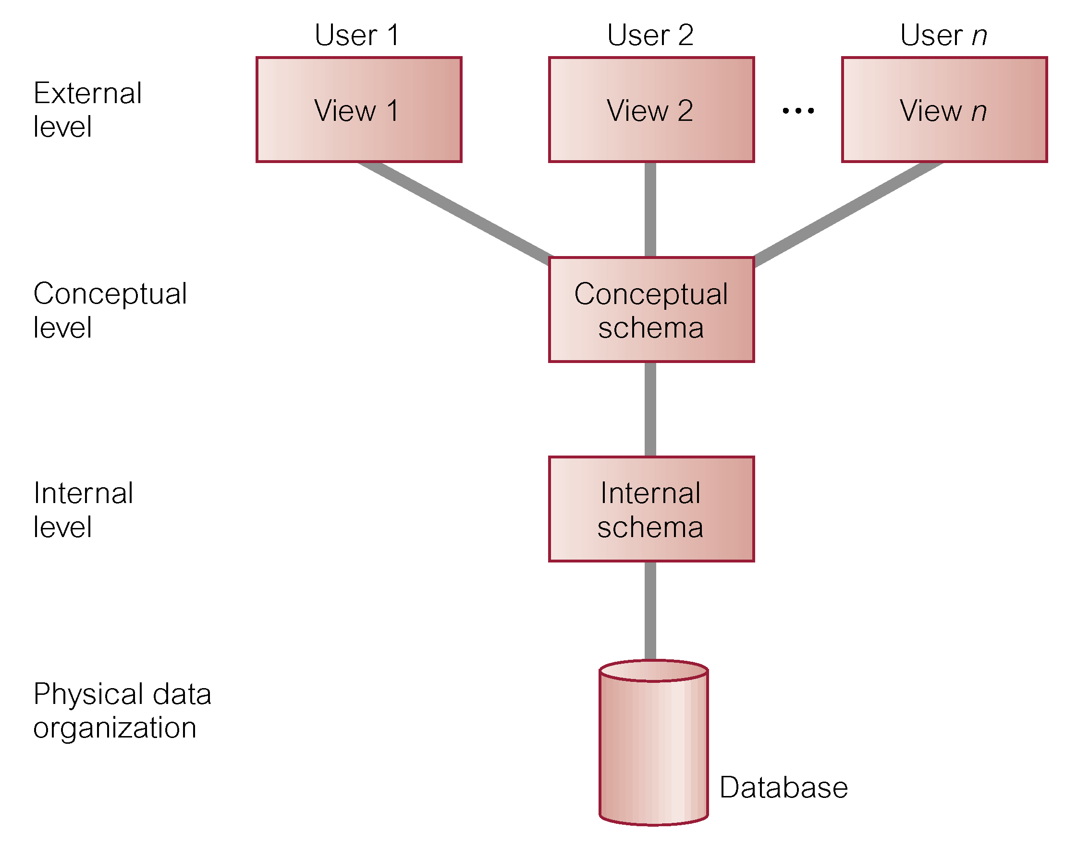
ANSI-SPARC Three-level Architecture

Slide 7
ANSI-SPARC Three-level Architecture
External Level
  Users' view of the database.
  Describes that part of database that is relevant to a particular user.
Conceptual Level
  Community view of the database.
  Describes what data is stored in database and relationships among the data.

Slide 8
ANSI-SPARC Three-level Architecture
Internal Level
  Physical representation of the database on the computer.
  Describes how the data is stored in the database.

Slide 9
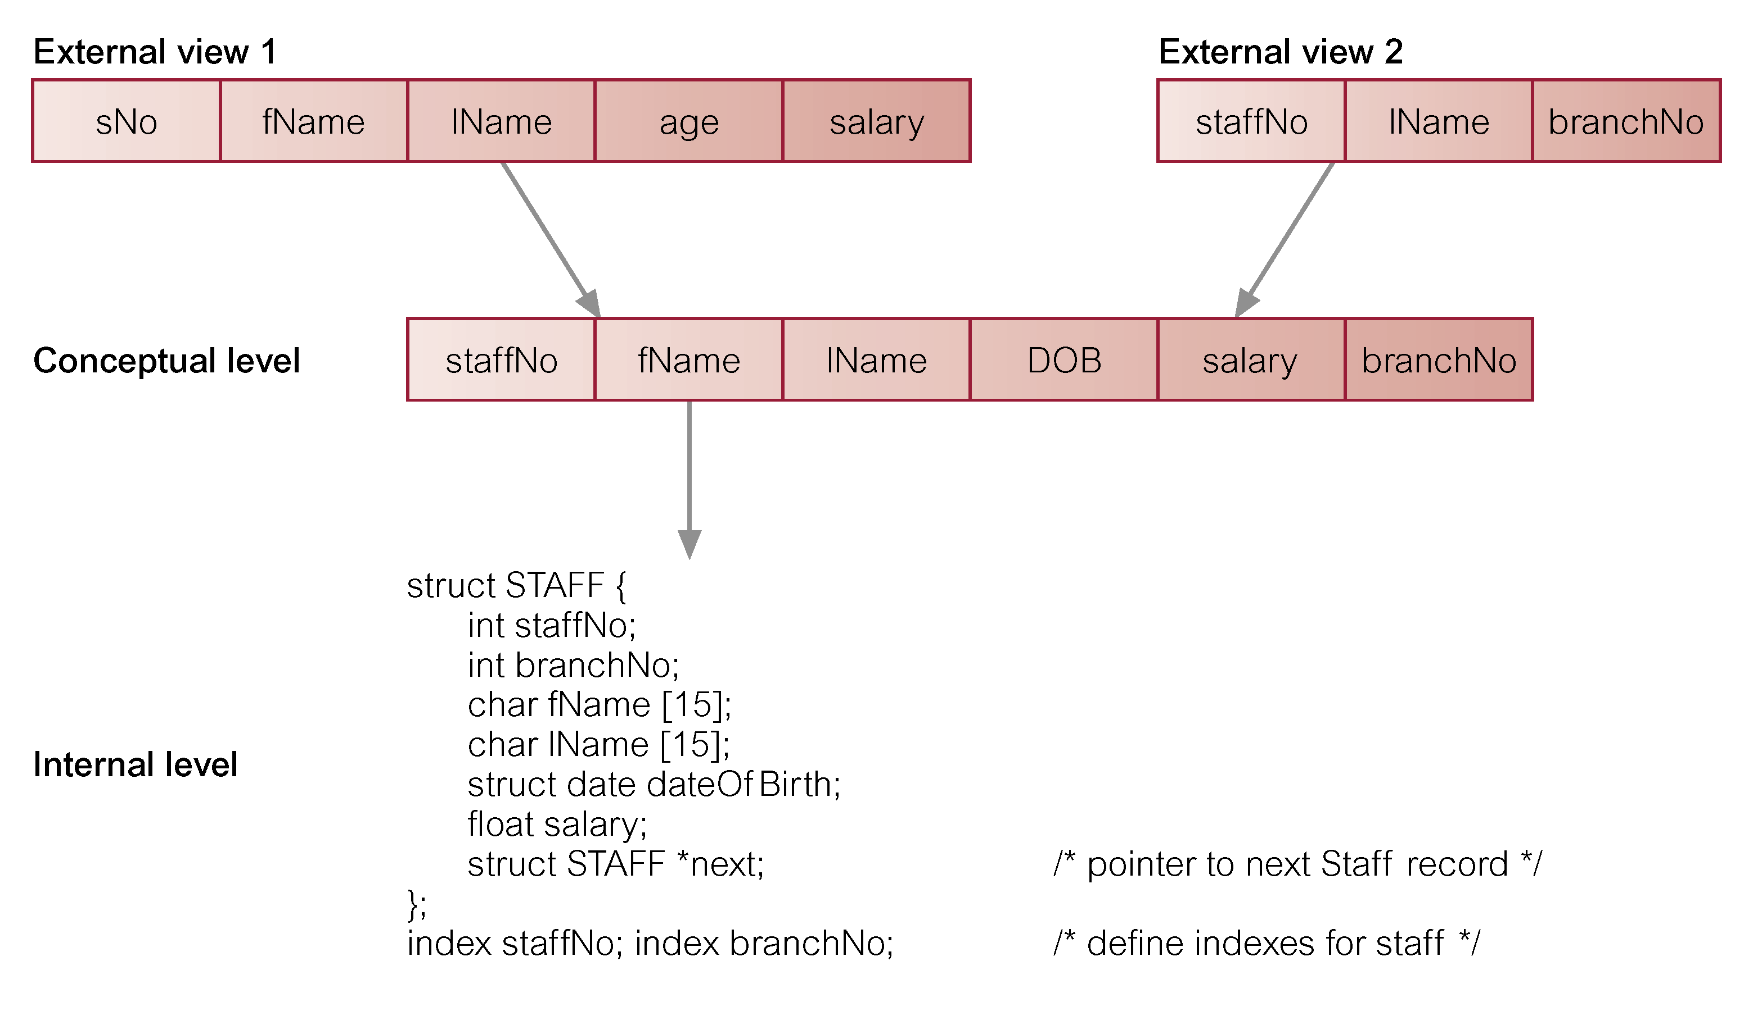
Differences between Three Levels of ANSI-SPARC Architecture

Slide 10
Data Independence
Logical Data Independence
  Refers to immunity of external schemas to changes in conceptual schema.
  Conceptual schema changes (e.g. addition/removal of entities).
  Should not require changes to external schema or rewrites of application programs.

Slide 11
Data Independence
Physical Data Independence
  Refers to immunity of conceptual schema to changes in the internal schema.
  Internal schema changes (e.g. using different file organizations, storage structures/devices).
  Should not require change to conceptual or external schemas.

Slide 12
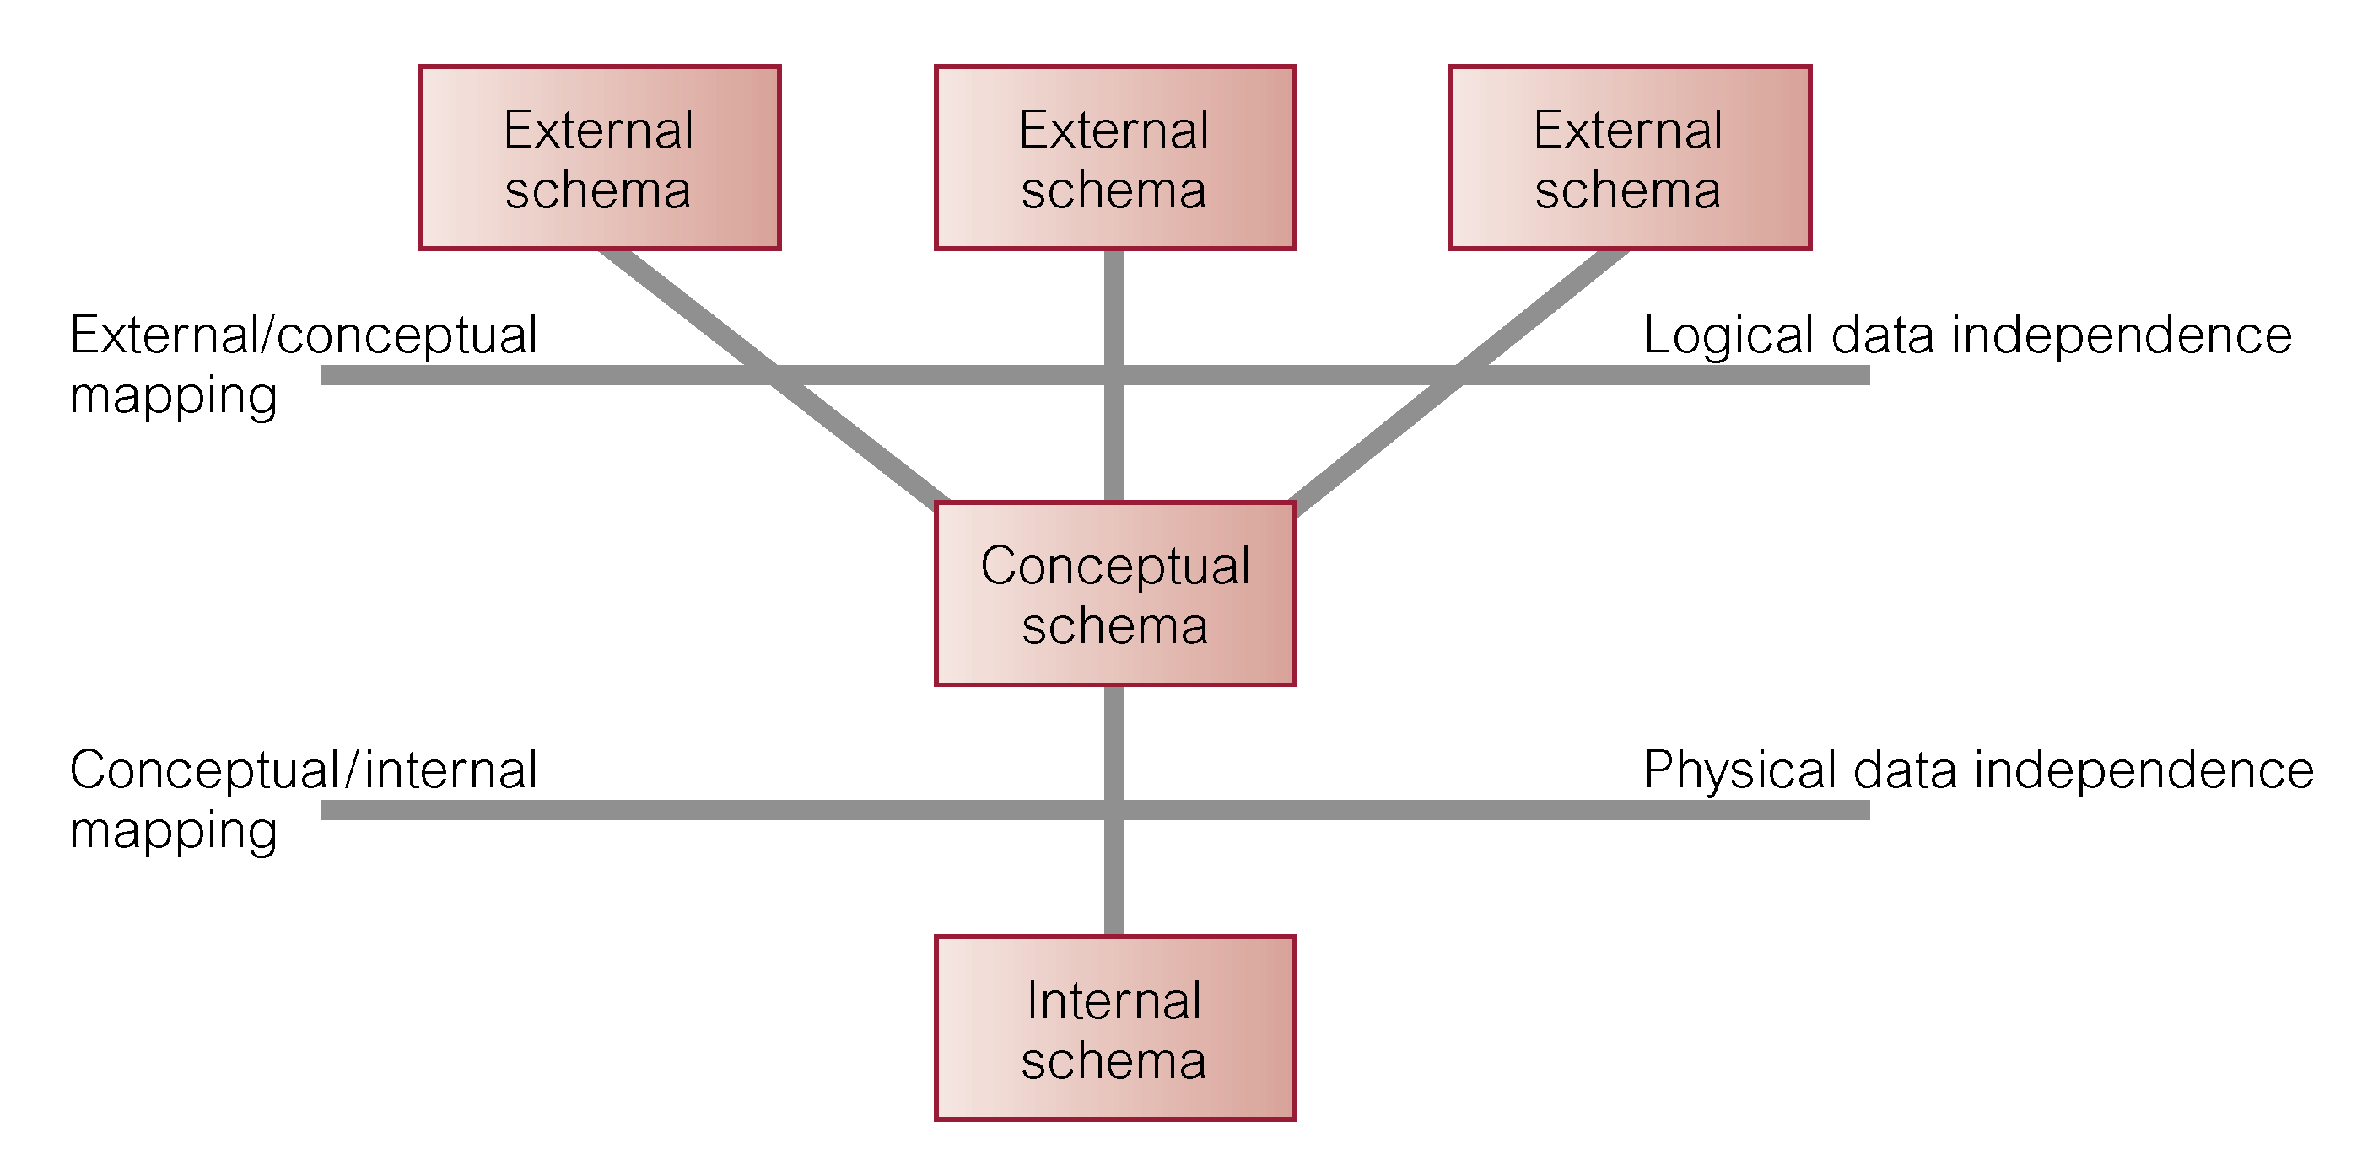
Data Independence and the ANSI-SPARC Three-level Architecture

Slide 13
Database Languages
Data Definition Language (DDL)
  Allows the DBA or user to describe and name entities, attributes, and relationships required for the application
  plus any associated integrity and security constraints.

Slide 14
Database Languages
Data Manipulation Language (DML)
  Provides basic data manipulation operations on data held in the database.
Procedural DML
  allows user to tell system exactly how to manipulate data.
Non-Procedural DML
  allows user to state what data is needed rather than how it is to be retrieved.

Slide 15
Nonprocedural Access
Loop
Query: request for data to answer a question
Indicate what parts of database to retrieve not the procedural details
Improve productivity and improve accessibility
SQL SELECT statement and graphical tools
Notes:
Specify what not how
Loop buster: no loops; major difference between procedural and nonprocedural language
Trip planning analogy: specify features of trip (destination, quality of accommodations, dates, …) but not details (route, hotel research, flight research, …)
Productivity improvement: 100 times fewer lines of code

Slide 16
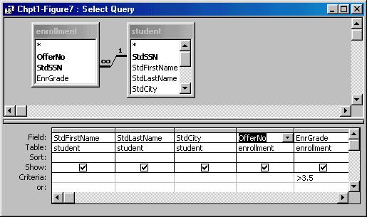
Graphical Tool for Nonprocedural Access
Notes:
Query Design (Access)
- specify tables and columns
- Access determines connections among tables

Slide 17
Procedural Language Interface
Combine procedural language with nonprocedural access
Why
  Batch processing
  Customization and automation
  Performance improvement
Notes:
Combine external languages (COBOL, Java, C, C++, …) with SQL
New DBMS specific languages: PL/SQL (Oracle), Transact-SQL (SQL Server)
Batch processing: much business processing is batch (collect loan applications and process together); online processing is becoming more prevalent because of the web;
Customization: customize the behavior of a data entry form
Automation: rule processing; check qoh when an order is placed
Performance: more control with a procedural language

Slide 18
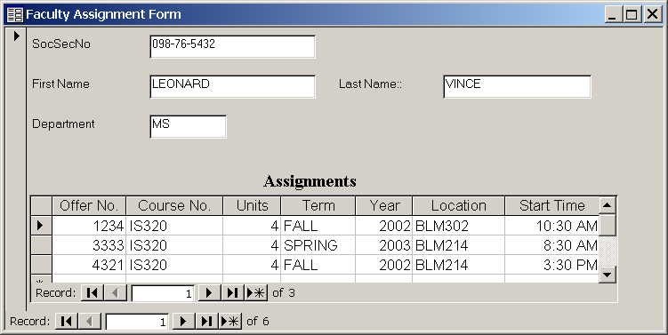
Sample Data Entry Form
Notes:
Faculty assignment form
The form can be used to add new course assignments for a professor and to change existing assignments.

Slide 19
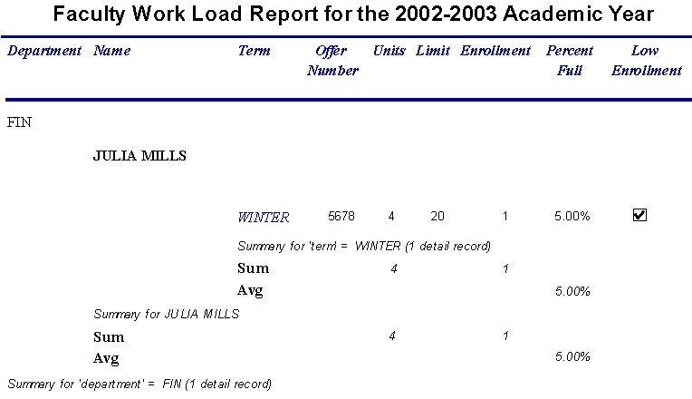
Sample Report
Notes:
The report uses indentation to show courses taught by faculty in various departments. The indentation style can be easier to view than the tabular style shown as default output style.

Slide 20
Database Languages
Fourth Generation Language (4GL)
  Query Languages
  Forms Generators
  Report Generators
  Graphics Generators
  Application Generators

Slide 21
Data Model
Integrated collection of concepts for describing data, relationships between data, and constraints on the data in an organization.
Data Model comprises:
  A structural part
  A manipulative part
  Possibly a set of integrity rules

Slide 22
Data Model
Purpose
  To represent data in an understandable way.
Categories of data models include:
  Object-based
  Record-based
  Physical

Slide 23
Data Models
Object-based Data Models
  Entity-Relationship
  Semantic
  Functional
  Object-Oriented
Record-based Data Models
  Relational Data Model
  Network Data Model
  Hierarchical Data Model
Physical Data Models

Slide 24
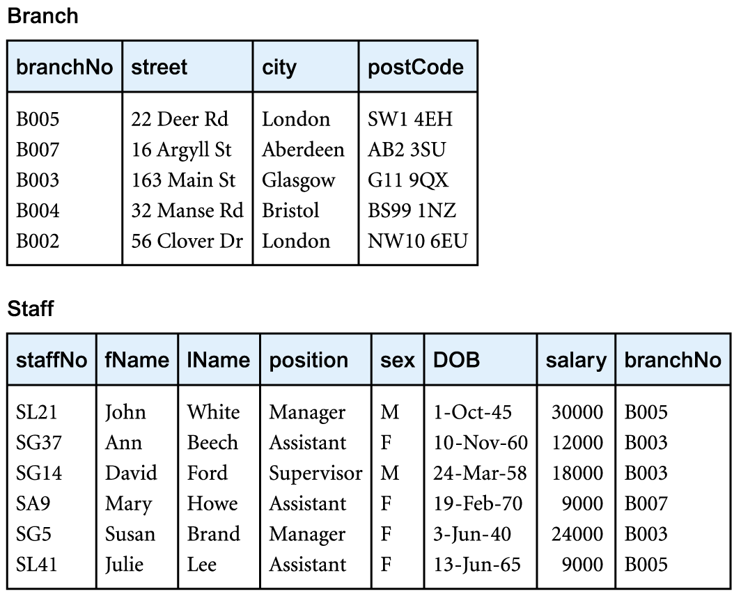
Relational Data Model

Slide 25
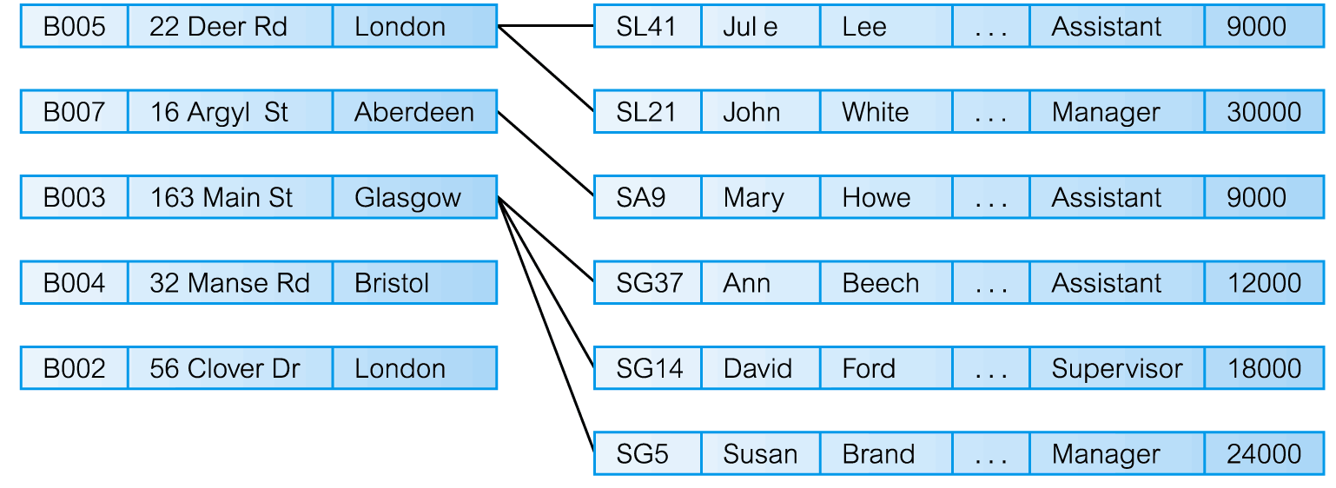
Network Data Model

Slide 26
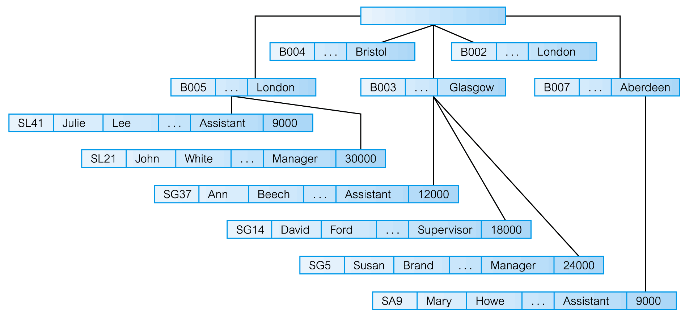
Hierarchical Data Model

Slide 27
Conceptual modeling
Conceptual schema is the core of a system supporting all user views.
Should be complete and accurate representation of an organization's data requirements.
Conceptual modeling is process of developing a model of information use that is independent of implementation details.
Result is a conceptual data model.

Slide 28
System Catalog
Repository of information (metadata) describing the data in the database.
One of the fundamental components of DBMS.
Typically stores:
  names, types, and sizes of data items;
  constraints on the data;
  names of authorized users;
  data items accessible by a user and the type of access;
  usage statistics.

Slide 29
Components of a DBMS
Major components of a DBMS:
  Query processor
  Database manager (DM)
  File manager
  DML preprocessor
  DDL compiler
  Catalog manager

Slide 30
Components of a DBMS
Major software components for database manager
  Authorization control
  Command processor
  Integrity checker
  Query optimizer
Transaction manager
Scheduler
Recovery manager
Buffer manager

Slide 31
Oracle Architecture
Oracle’s logical database structure
  Tablespaces
  Schemas
  Data blocks
  Extents/segments

Slide 32
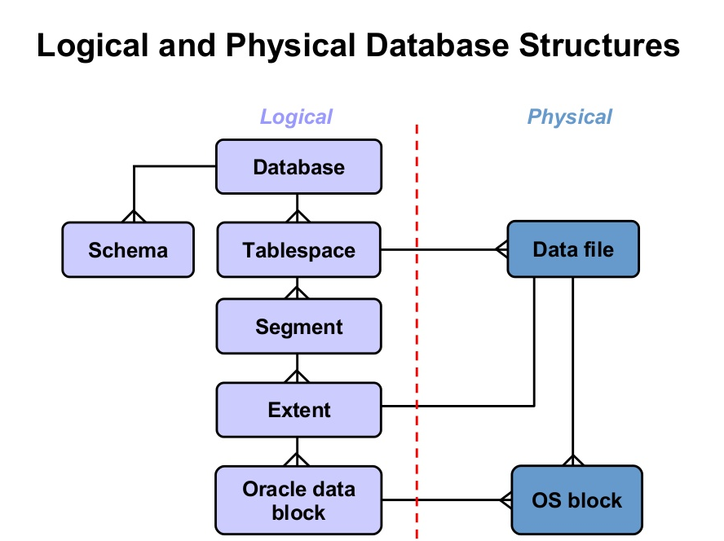

Slide 33
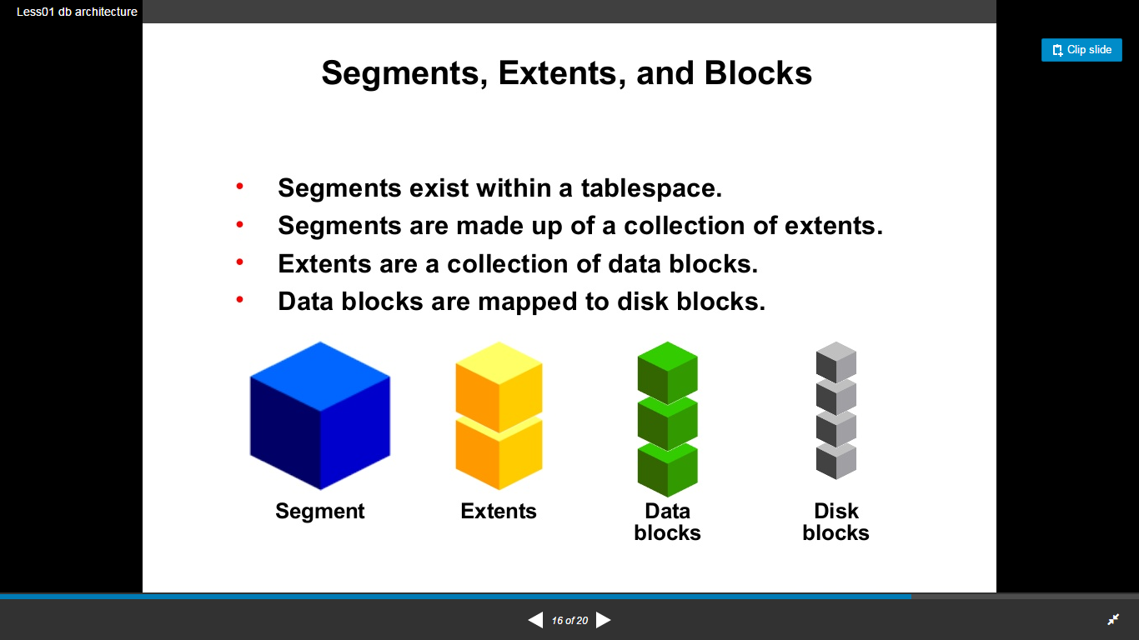

Slide 34
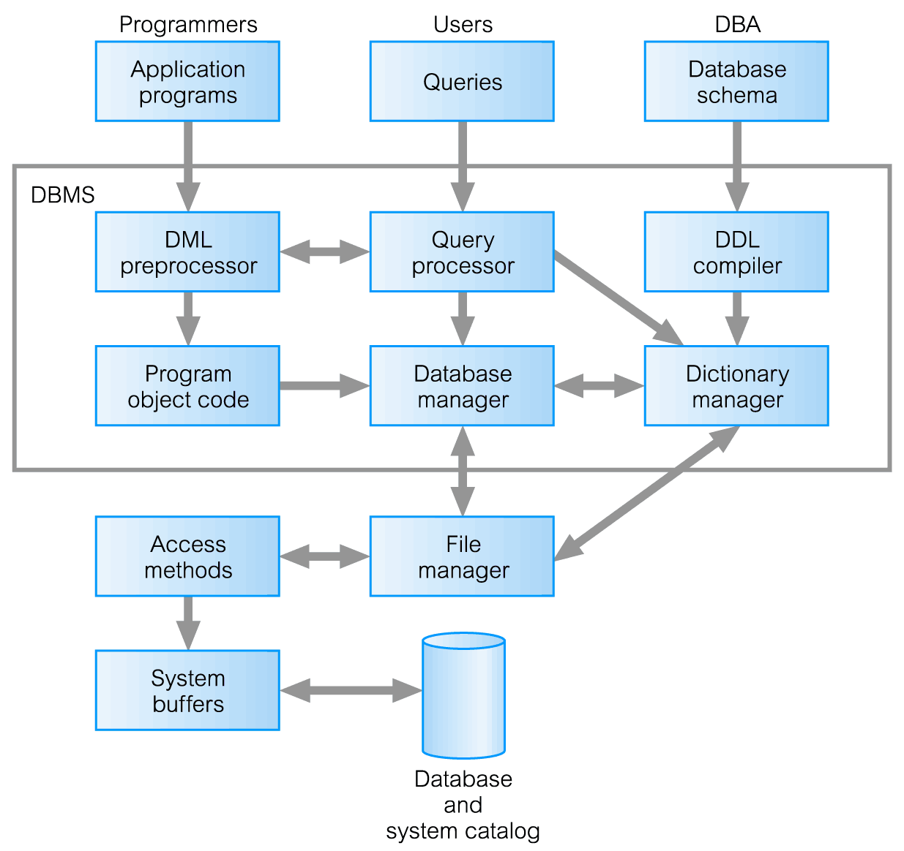
Components of a DBMS

Slide 35
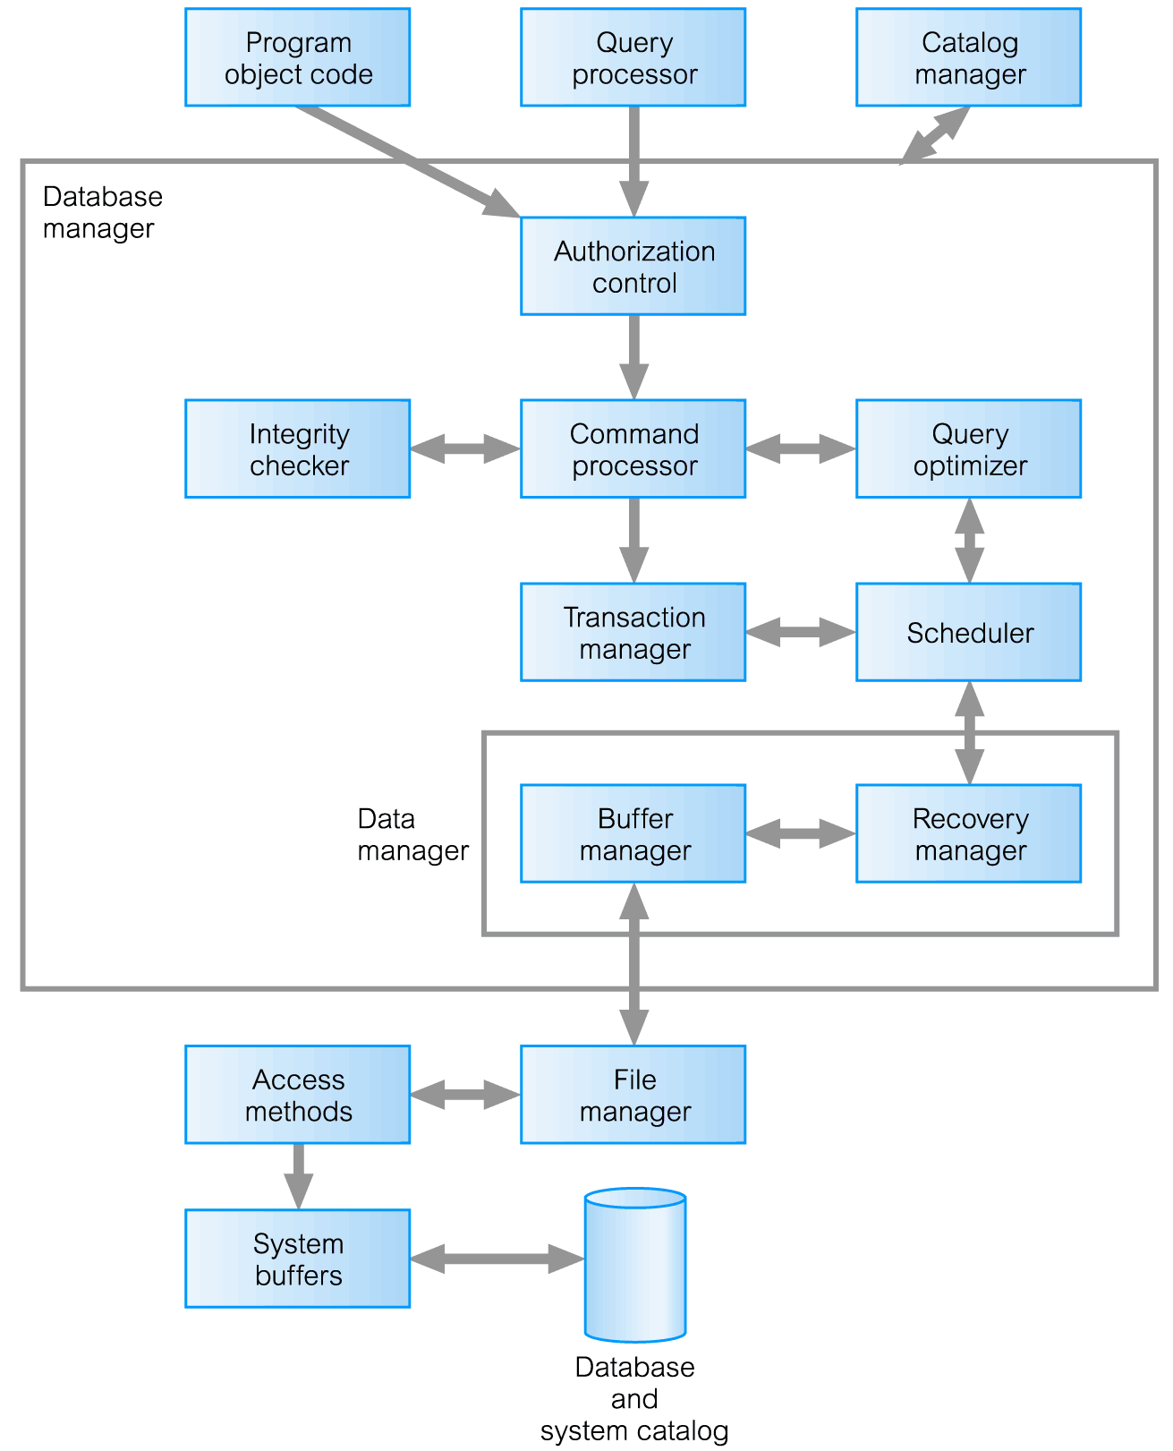
Components of Database Manager (DM)

Slide 36
Oracle Architecture
Oracle’s physical database structure
  Datafiles
  Redo log files
  Control files
The Oracle instance
  Oracle processes and shared memory required to access information in the database

Slide 37
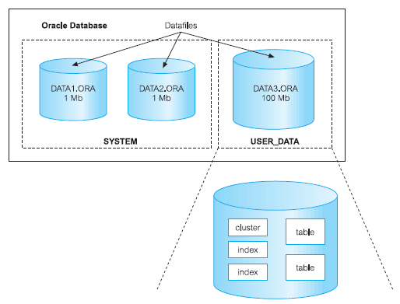
Relationship between an Oracle Database,
Tablespaces, and Datafiles

